Slide 1
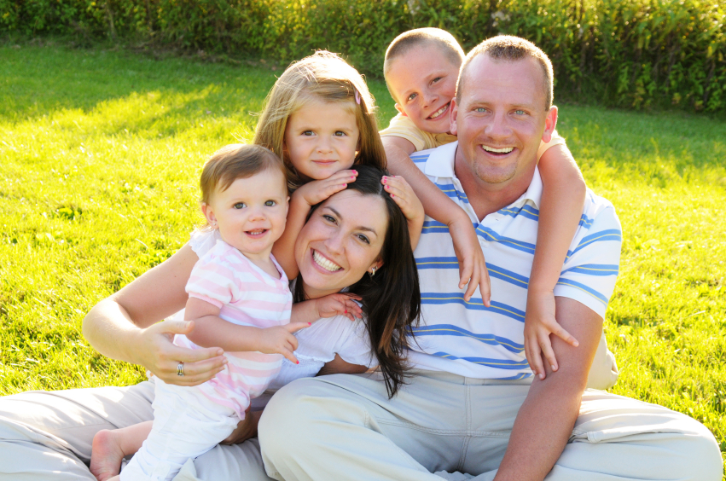
Families and Trauma

Slide 2
According to Integratedlistening.com, trauma is the response to a deeply distressing or disturbing event that overwhelms an individual’s ability to cope, causes feelings of helplessness, and diminishes their sense of self and their ability to feel the full range of emotions and experiences.
Families all experience trauma differently. You have to take into account many factors associated with each situation like a child’s age or the families’ culture and ethnicity. All of these factors affect how a family can cope/recover from a traumatic event. These events are known to change families in many ways. As each individual works to overcome the emotional and sometimes physical obstacles everyone heals at a different pace.
For some the adjustment to life after trauma can be smooth. While others find they become more stress and feel the burden of the event. It can cause someone to become overwhelmed, feel alone and even withdrawal from family and their regular activities.
Traumas are frightening experiences. Many are violent, sometimes life threatening and force the body into what is known as a traumatic stress response. Those feelings and emotions are felt throughout the entire family, so much so that life just doesn’t always run the same way as it did before.
However, there is life after a traumatic event. It takes time and support from everyone involved. Together as a family you can come out of this stronger than ever before.

Slide 3
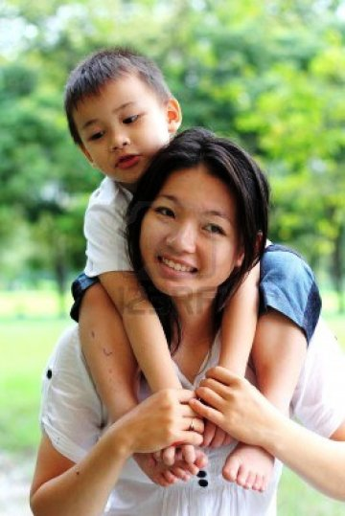
When it comes to responding to a traumatic event it can sometime be difficult to remember that everyone handles and reacts to the same traumatic event differently. Even the closest of families can be shaken. Depending on each family member’s age, experience level, trauma history and developmental level, these factors can all determine how they respond to a situation with the child family member affected by trauma or even their own personal experience with the situation.
In every traumatic event there is a victim, a family member whom they confided into, maybe another family member who had witnessed the trauma and or a family member who just overheard the situation. Everyone involved can all have different responses. Some will experience a traumatic stress reaction while other will need time to recover from the experience.

Slide 4
How does trauma affect families?
All families change as they work to overcome and adapt to their new circumstances and environment cause by trauma. The range of impact is different for all individual family member. It can change the way families relate to one another and even change the overall functioning of the family.
There are many different reactions to a traumatic event. Initially a victim or family may feel or be in distress. Family members can also begin to feel physical changes from the experience. Whether it is headaches, sleeping problems, and digestion problems, high blood pressure of mental health problems like post-traumatic stress disorder or depression. These response can be found in both adults and children. They may happen right away or begin to evolve and change and show up over time.
Often we see the adult partners or parents of the children of trauma feel a high level of stress. When working together to cope with the situation the stress can begin to wear them down. They may find they begin to have trouble communicating, remaining close and or being able to manage their emotions. This can increase the chances of separation between the adults as well as violence between the couples.

Slide 5
How does trauma affect family relationships?
In the face of recovery a parent child relationship can truly aid in the child’s development and recovery to the trauma. Protection, support and guidance from a loving parent can speed up the recovery process for a child coping with facing their trauma. When parents begin to struggle themselves with the trauma and withdrawal from the situation parents are likely to show their own signs of behavioral and physical health problems. They begin to miss and have trouble being aware of their own child’s reactions and responses to the traumatic event and it begins to change the overall parent child relationship.
Siblings can be a great source of companionship and comfort during this difficult time. They are able to build on the family connection and support the family and the victim as they all begin to learn to live under the new stressful conditions created by the trauma. However if the sibling situation was already a difficult one it can lead to an even more difficult situation. It has its ability to increase rivalries amongst the siblings and you may even see more intense conflict amongst the children. It has its ability to increase feelings of rejection and ultimately challenge the family dynamic once again.
The family as a unit can provide many resources to help each other to meet the basic needs of everyone involved. Remember, families have the ability to create a loving environment, where their basic necessities of food shelter and health are all available. Traumatic events have a way of draining the resources available within the family. With new burdens of attending court proceedings, moving to a new home, changing schools and loosing friends. The traumatic event is and can be devastating. Maintaining consistency as much as possible and keeping to a similar routine from prior to the traumatic event has been shown to be positive.

Slide 6
How can providers support families after trauma?
Families play an important role in helping children recover from trauma. If families are able to continue to maintain routines and traditions that existed prior to the trauma families will find it easy to acknowledge when there is a shift in feelings thoughts and emotions of family members involved. It is so important for everyone involved to continue to talk, laugh and share great memories during this difficult time. It strengthens the bond between everyone involved. It has been found that the more involved and supportive a family become during the difficult time has the ability to create a better response to the event and ultimately more positive results within the family member themselves. Involving experience heath professionals and providers has also shown to support the overcoming of the traumatic event as well as unifying and providing the family members the necessary tools to uniting under difficult circumstances.

